Slide 1
TELECOM CUSTOMER CHURN PREDICTION
Comparative study of sampling methods for better predictions
Presented by - Group 15 -Chandra Kishor Mishra -Harish Rajan -Justin Seale -Shubhinder Singh Rana
-Sujay Shrivastava

Slide 2
Content
1. Introduction
2. Data Set Insights
3. Experimental Design
4. Findings
5. Future Scope
6. Q&A

Slide 3
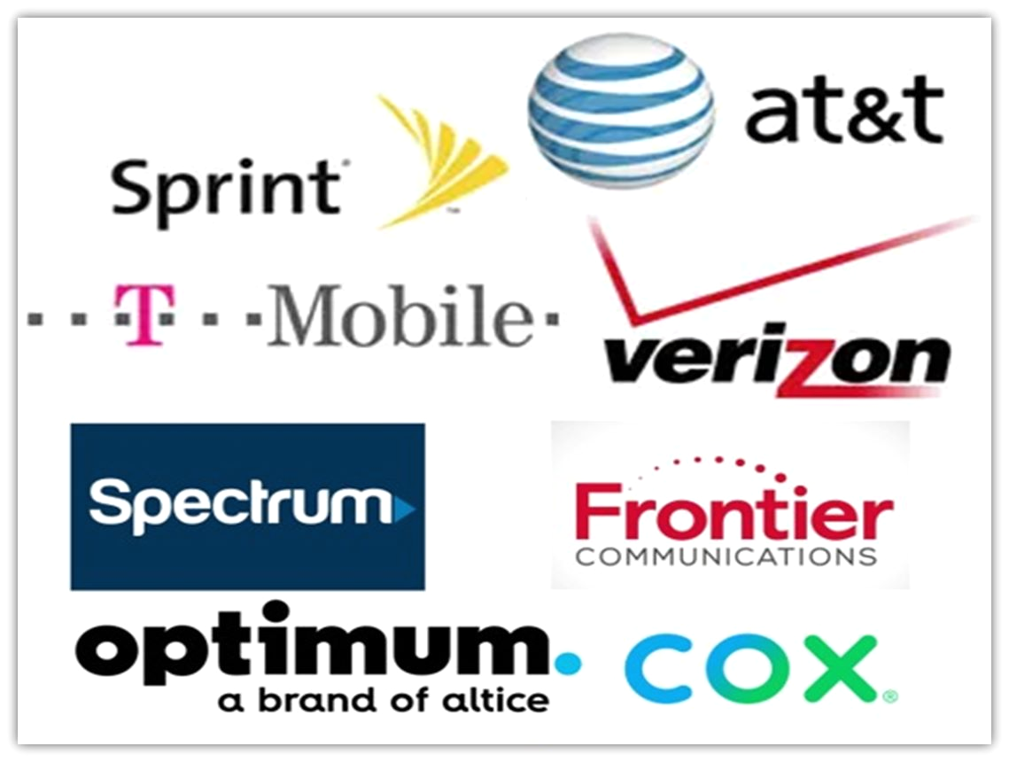
.
Background-Churn
Term used to describe customer attrition or loss
Current Challenges
Difficult to retain existing customers.
Technical challenges
Class imbalance
Better prediction than a random guess.
Decline in customer loyalty
Taming the model bias.
To increase customer lifetime value.

Slide 4

Challenges in data science formulation
The objective is to predict churn with a high accuracy, in advance the customers who may be attrite from the existing service provider in near future.
Technical challenges
Class imbalance
Improve effectiveness of churn models using different sampling techniques to tame class imbalance

Slide 5
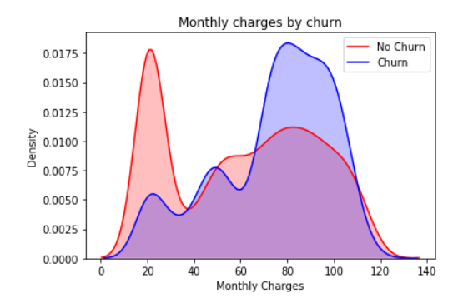
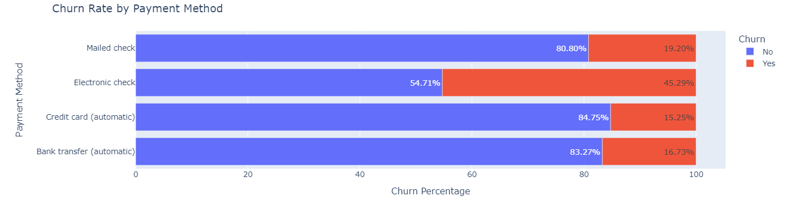
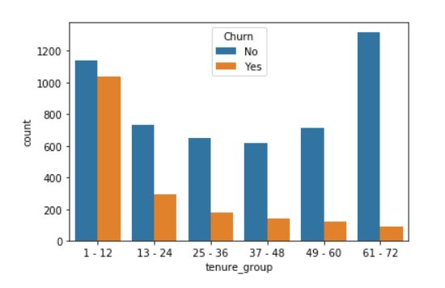
Insights on dataset
Data consists of 7043 fictional customers who belong to a variety of demographics (single; with dependents; senior citizen) and subscribe to a variety of products (internet service, telephone line, streaming TV, streaming movies, and online security) from a telecom company located in one of the US states.

Slide 6
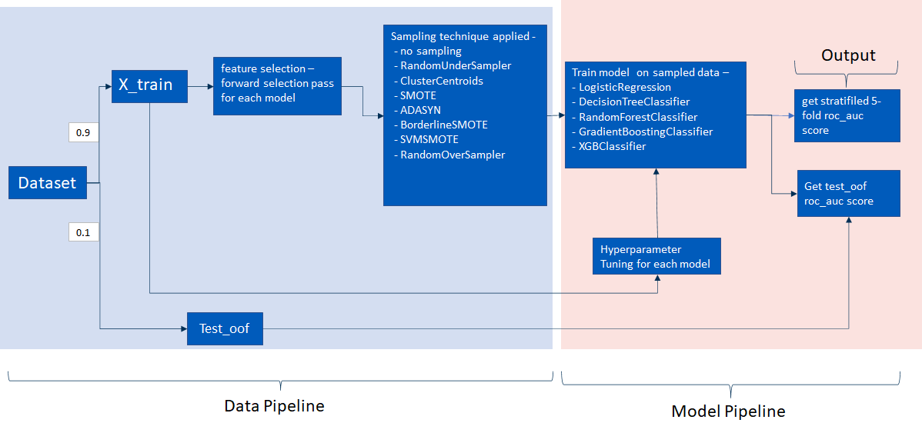
Experiment Flow

Slide 7
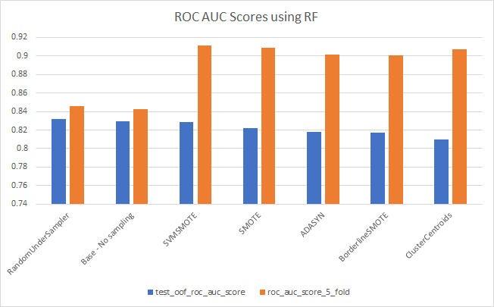
Findings
Undersampling methods performed better for most of the classification models.
Random Forest performed the best in predicting the customer churn implying that bagging based methods are more suitable for prediction where class imbalance is present.
A lift in cv scores while using upsampling doesn't necessarily translate to a better performance on unknown data.
Lift in cv scores while upsampling can be attributed to more balanced data to evaluate model on, rather than the better fit of data.

Slide 8
Future Scope
Alter model to help provide insight into potential targeted marketing and future profit.
The tenure of a customer to help predict future profit
How likely a customer is to sign up for extra services (ex: Device protection, Tech Support, etc)
See how extra services affect customer churn.
Add additional demographic factors to see how model is affected.
Economic condition, geographic area, etc.
Create generalized model for other markets.
Insurance company churn rate, Gym membership retention
Integrating with other systems
Telcos can integrate the churn prediction model with other systems such as customer relationship management and billing systems to automate customer retention campaigns and streamline operations
Implementing real-time scoring
Telcos can implement real-time scoring of the churn prediction model to receive continuous churn risk scores for each customer.

Slide 9
Q&A

